Slide 1
Golfswing
10 June 2023

Slide 2
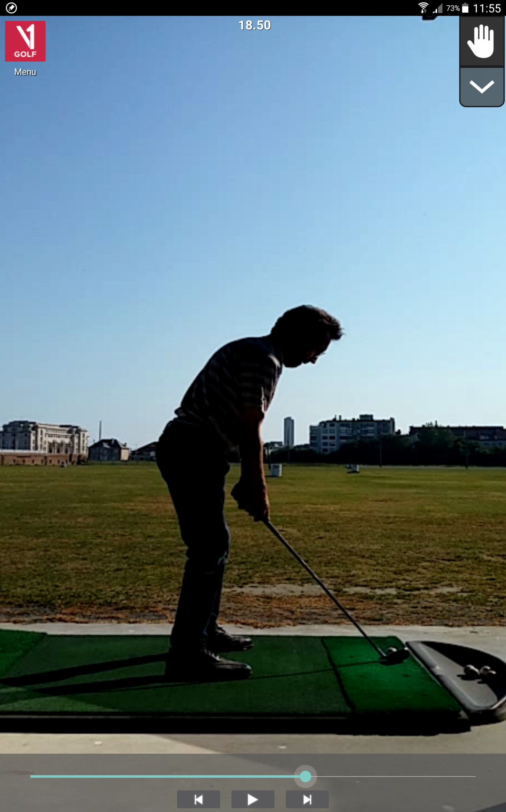
Initial backswing plane
(-) Head should remain stable
(-) Align the back of the head with the back spine
(+) Back spine is the main axis used during the golfswing
(-) Ankle should be in the middle of the 2 most outer vertical lines
(+) Knees above the balls of the feet
50⁰
Initial backswing plane

Slide 3
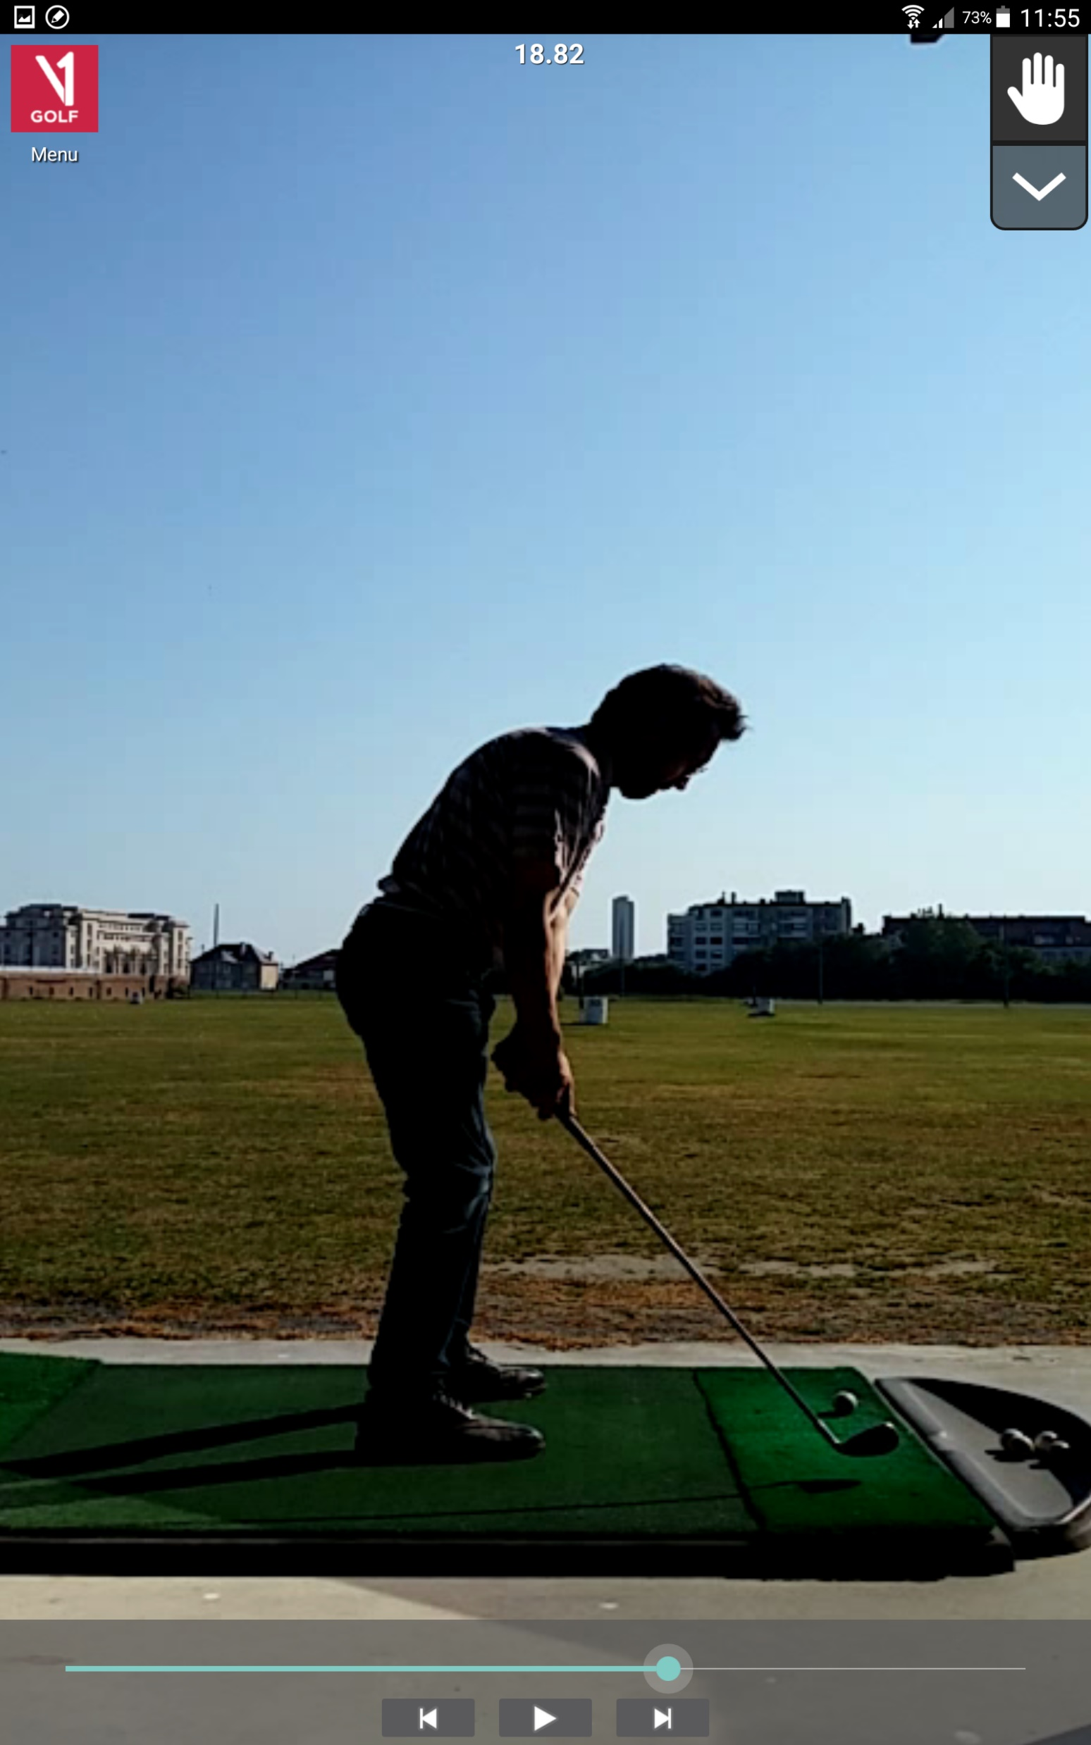
(-) Head is dropping downward and moving foreward
(+) One-piece takeaway, shoulders are in the lead, hands are passive
One-piece takeaway breaks down when the hands reach the right trouser pocket

Slide 4

(+) Right hand cups using the thumb as an axis → clubhead on plane
(+) Shoulders continue to turn around the back spine axis, until top of swing
(+) Backswing is controlled by right arm strength

Slide 5

(+) Clubshaft in line with backswing plane, powered by the right arm

Slide 6

(+) Clubface closed

Slide 7


Slide 8


Slide 9


Slide 10


Slide 11


Slide 12

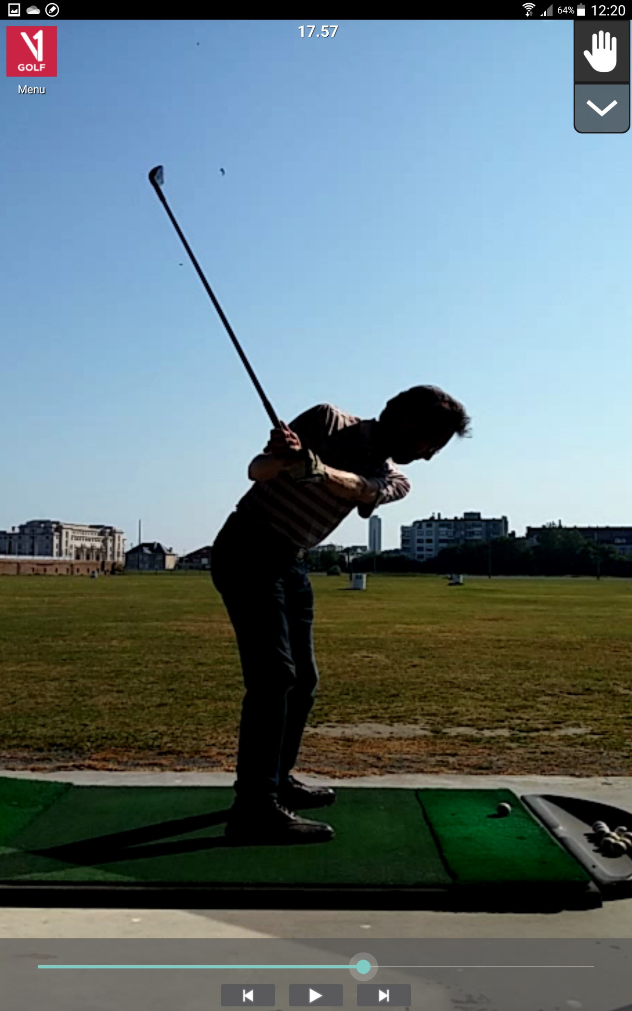
GOOD
BETTER
backswing plane #2
backswing plane #2
Backswing
plane #1
Backswing
plane #1

Slide 13


Slide 14
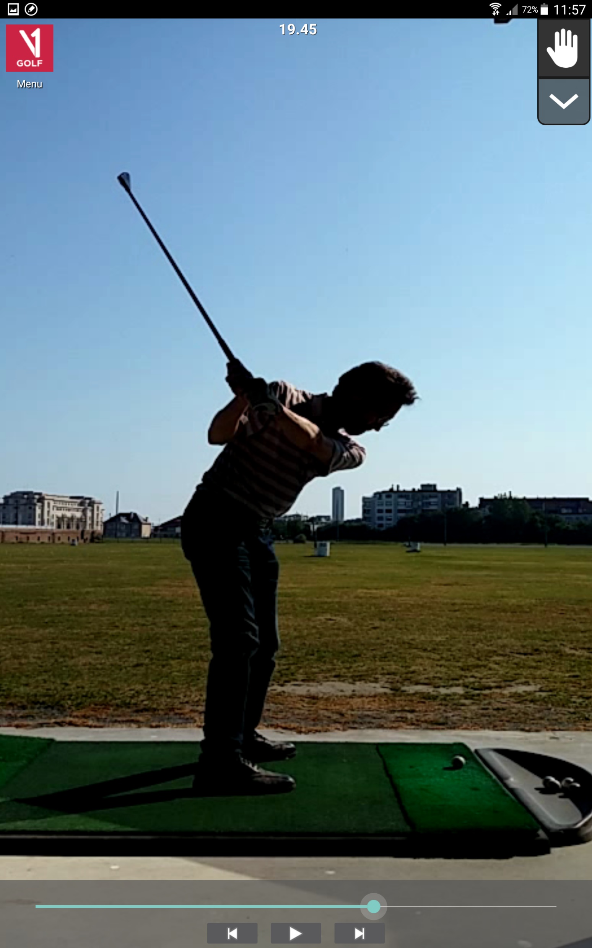

Slide 15
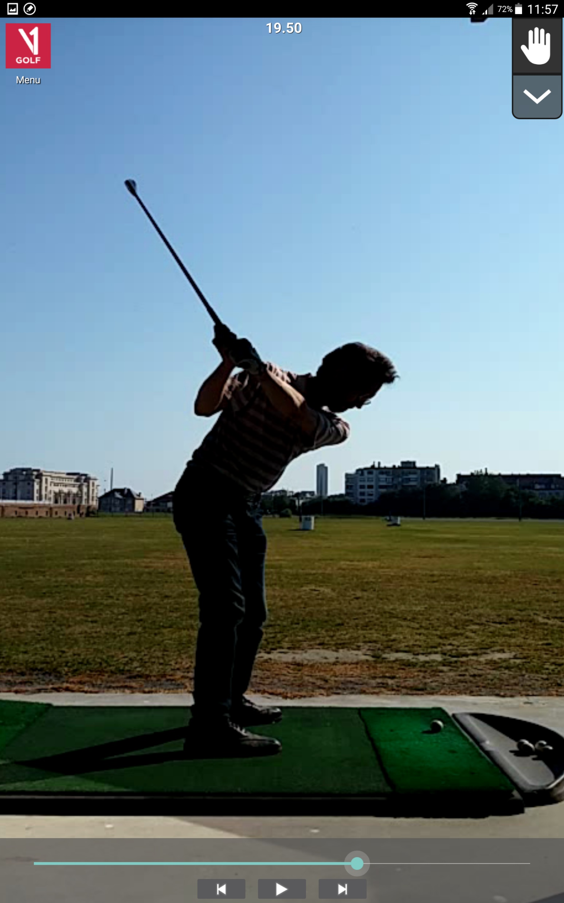

Slide 16


Slide 17


Slide 18
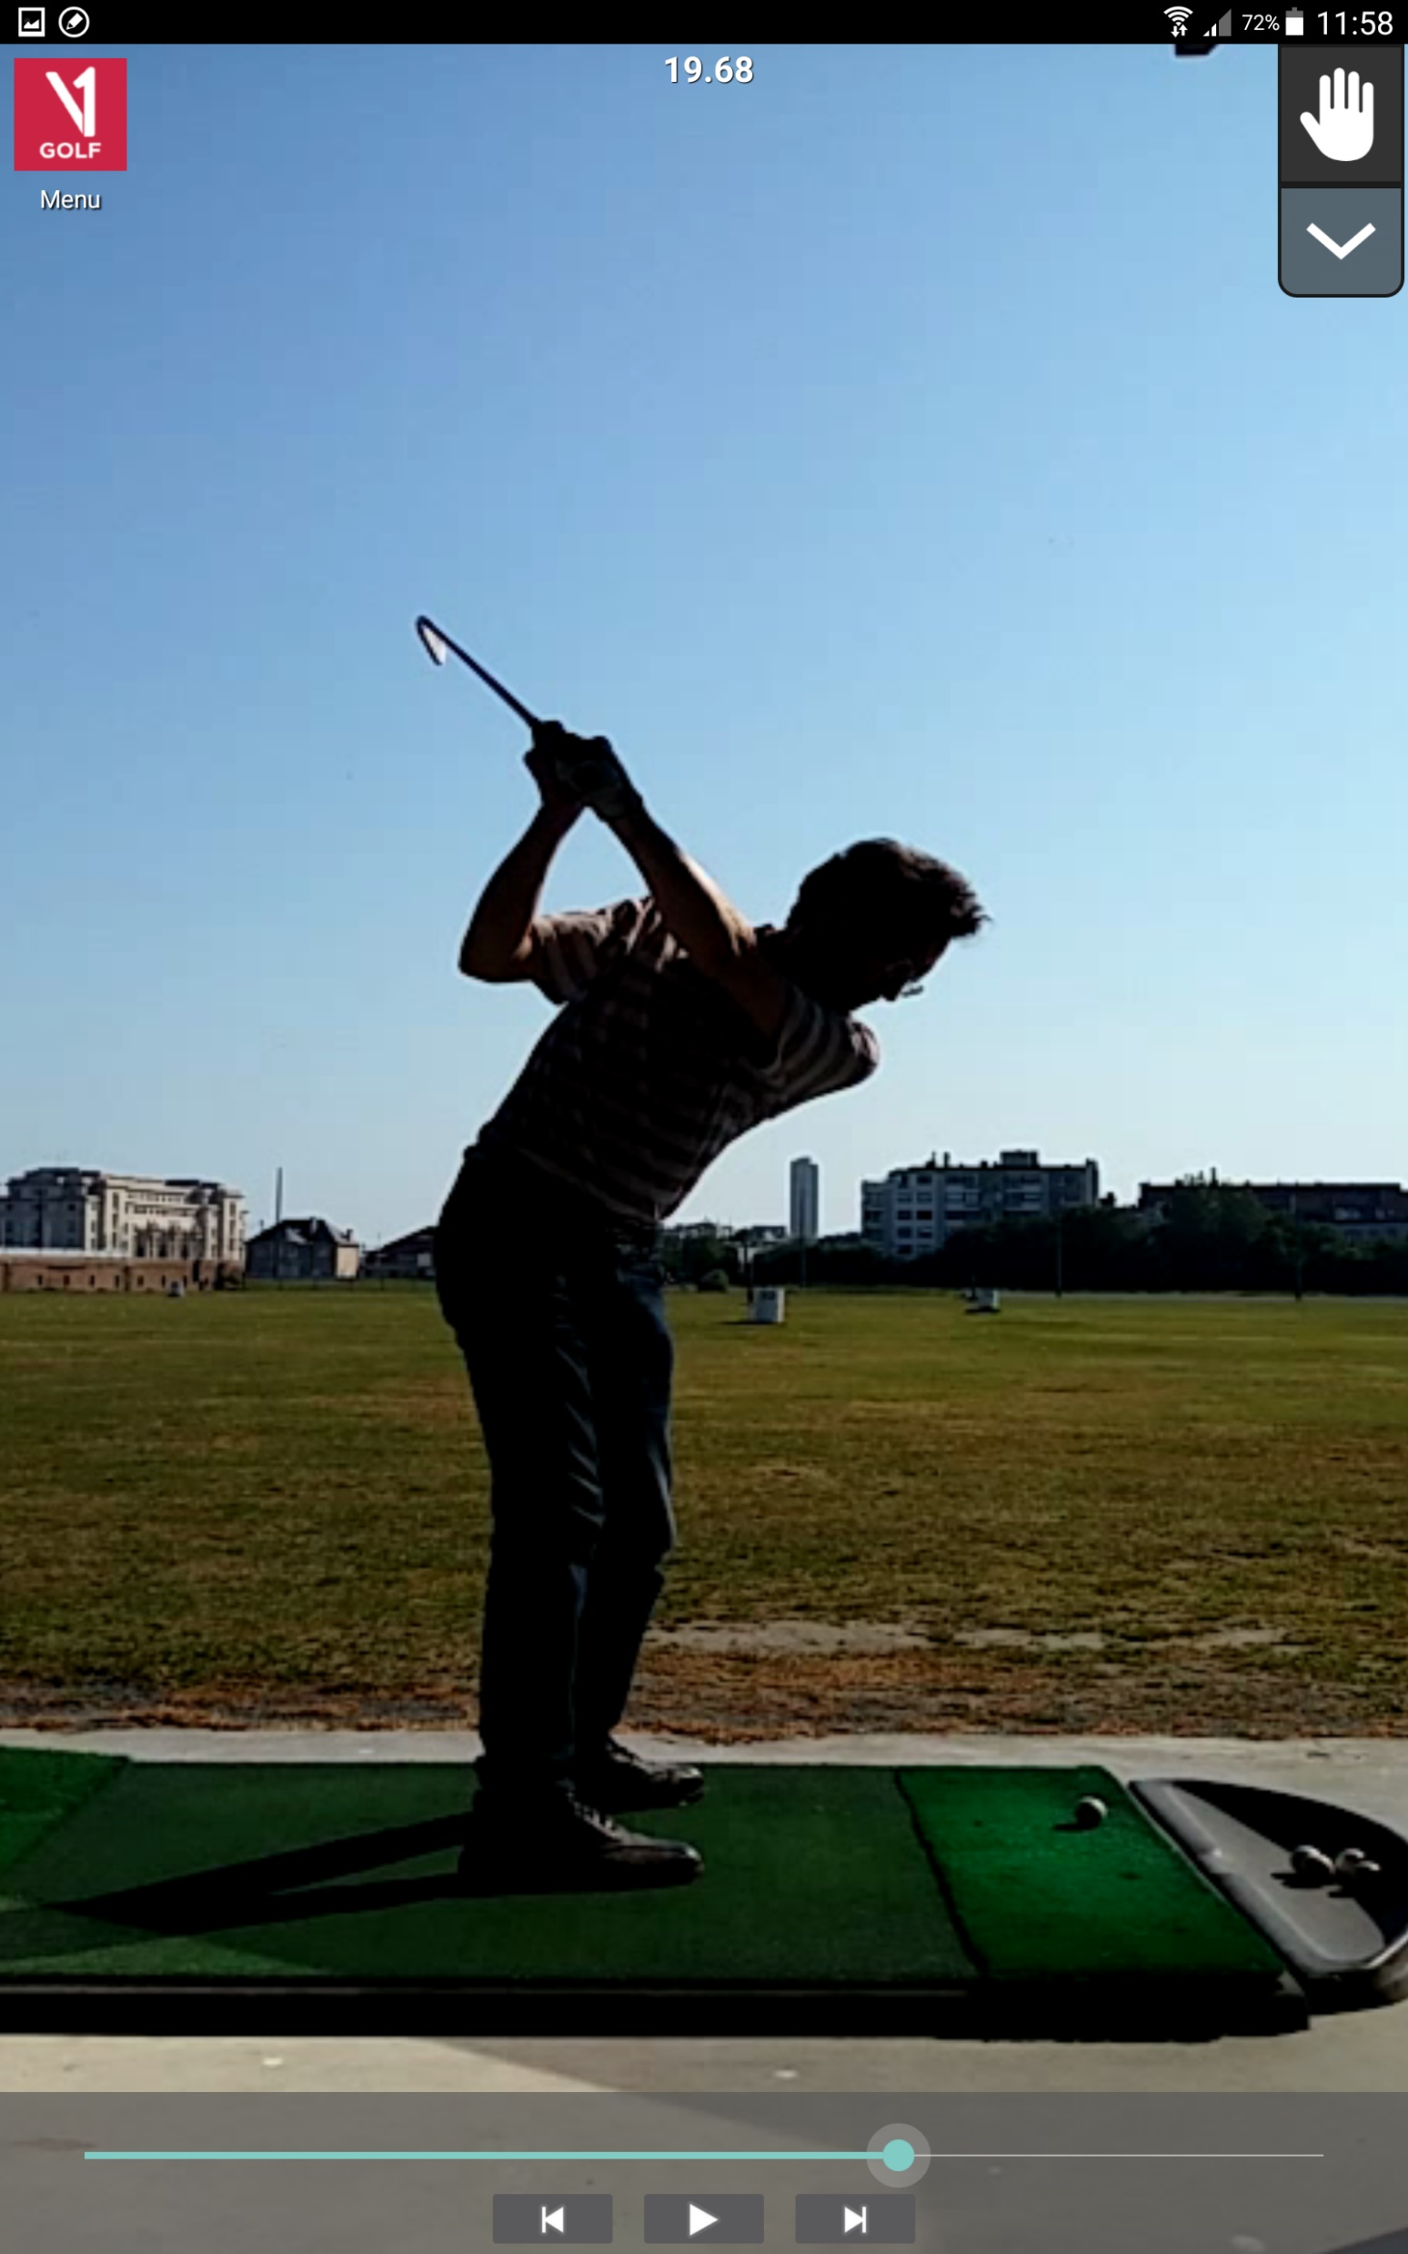

Slide 19


Slide 20
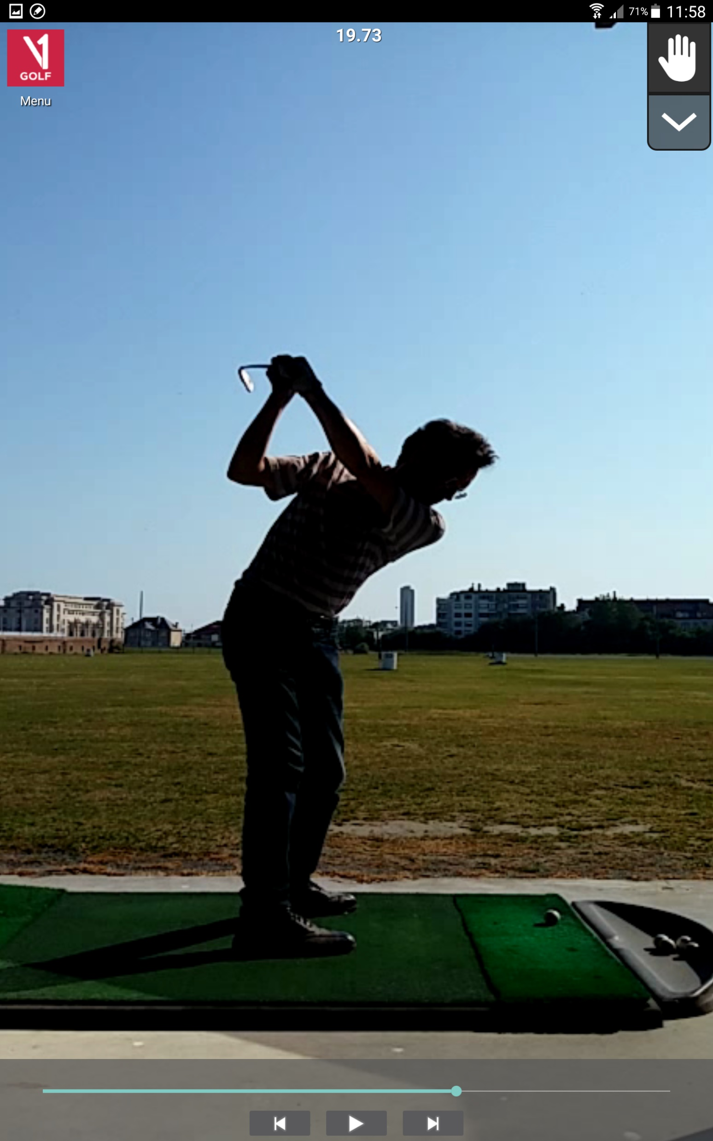
(-) Clubshaft should be parallel with the target line
(+) Clubface is parallel with backswing plane

Slide 21

(+) Backswing stops when the clubshaft is horizontal
(+) Chin touches the left shoulder, if the upper body turned sufficiently
(+) Upper body square to the target line
Keep everything well connected, especially around the top of the swing, don’t let the swing break down

Slide 22

(-) Right elbow should not be too backward, right forearm should be vertical at most

Slide 23
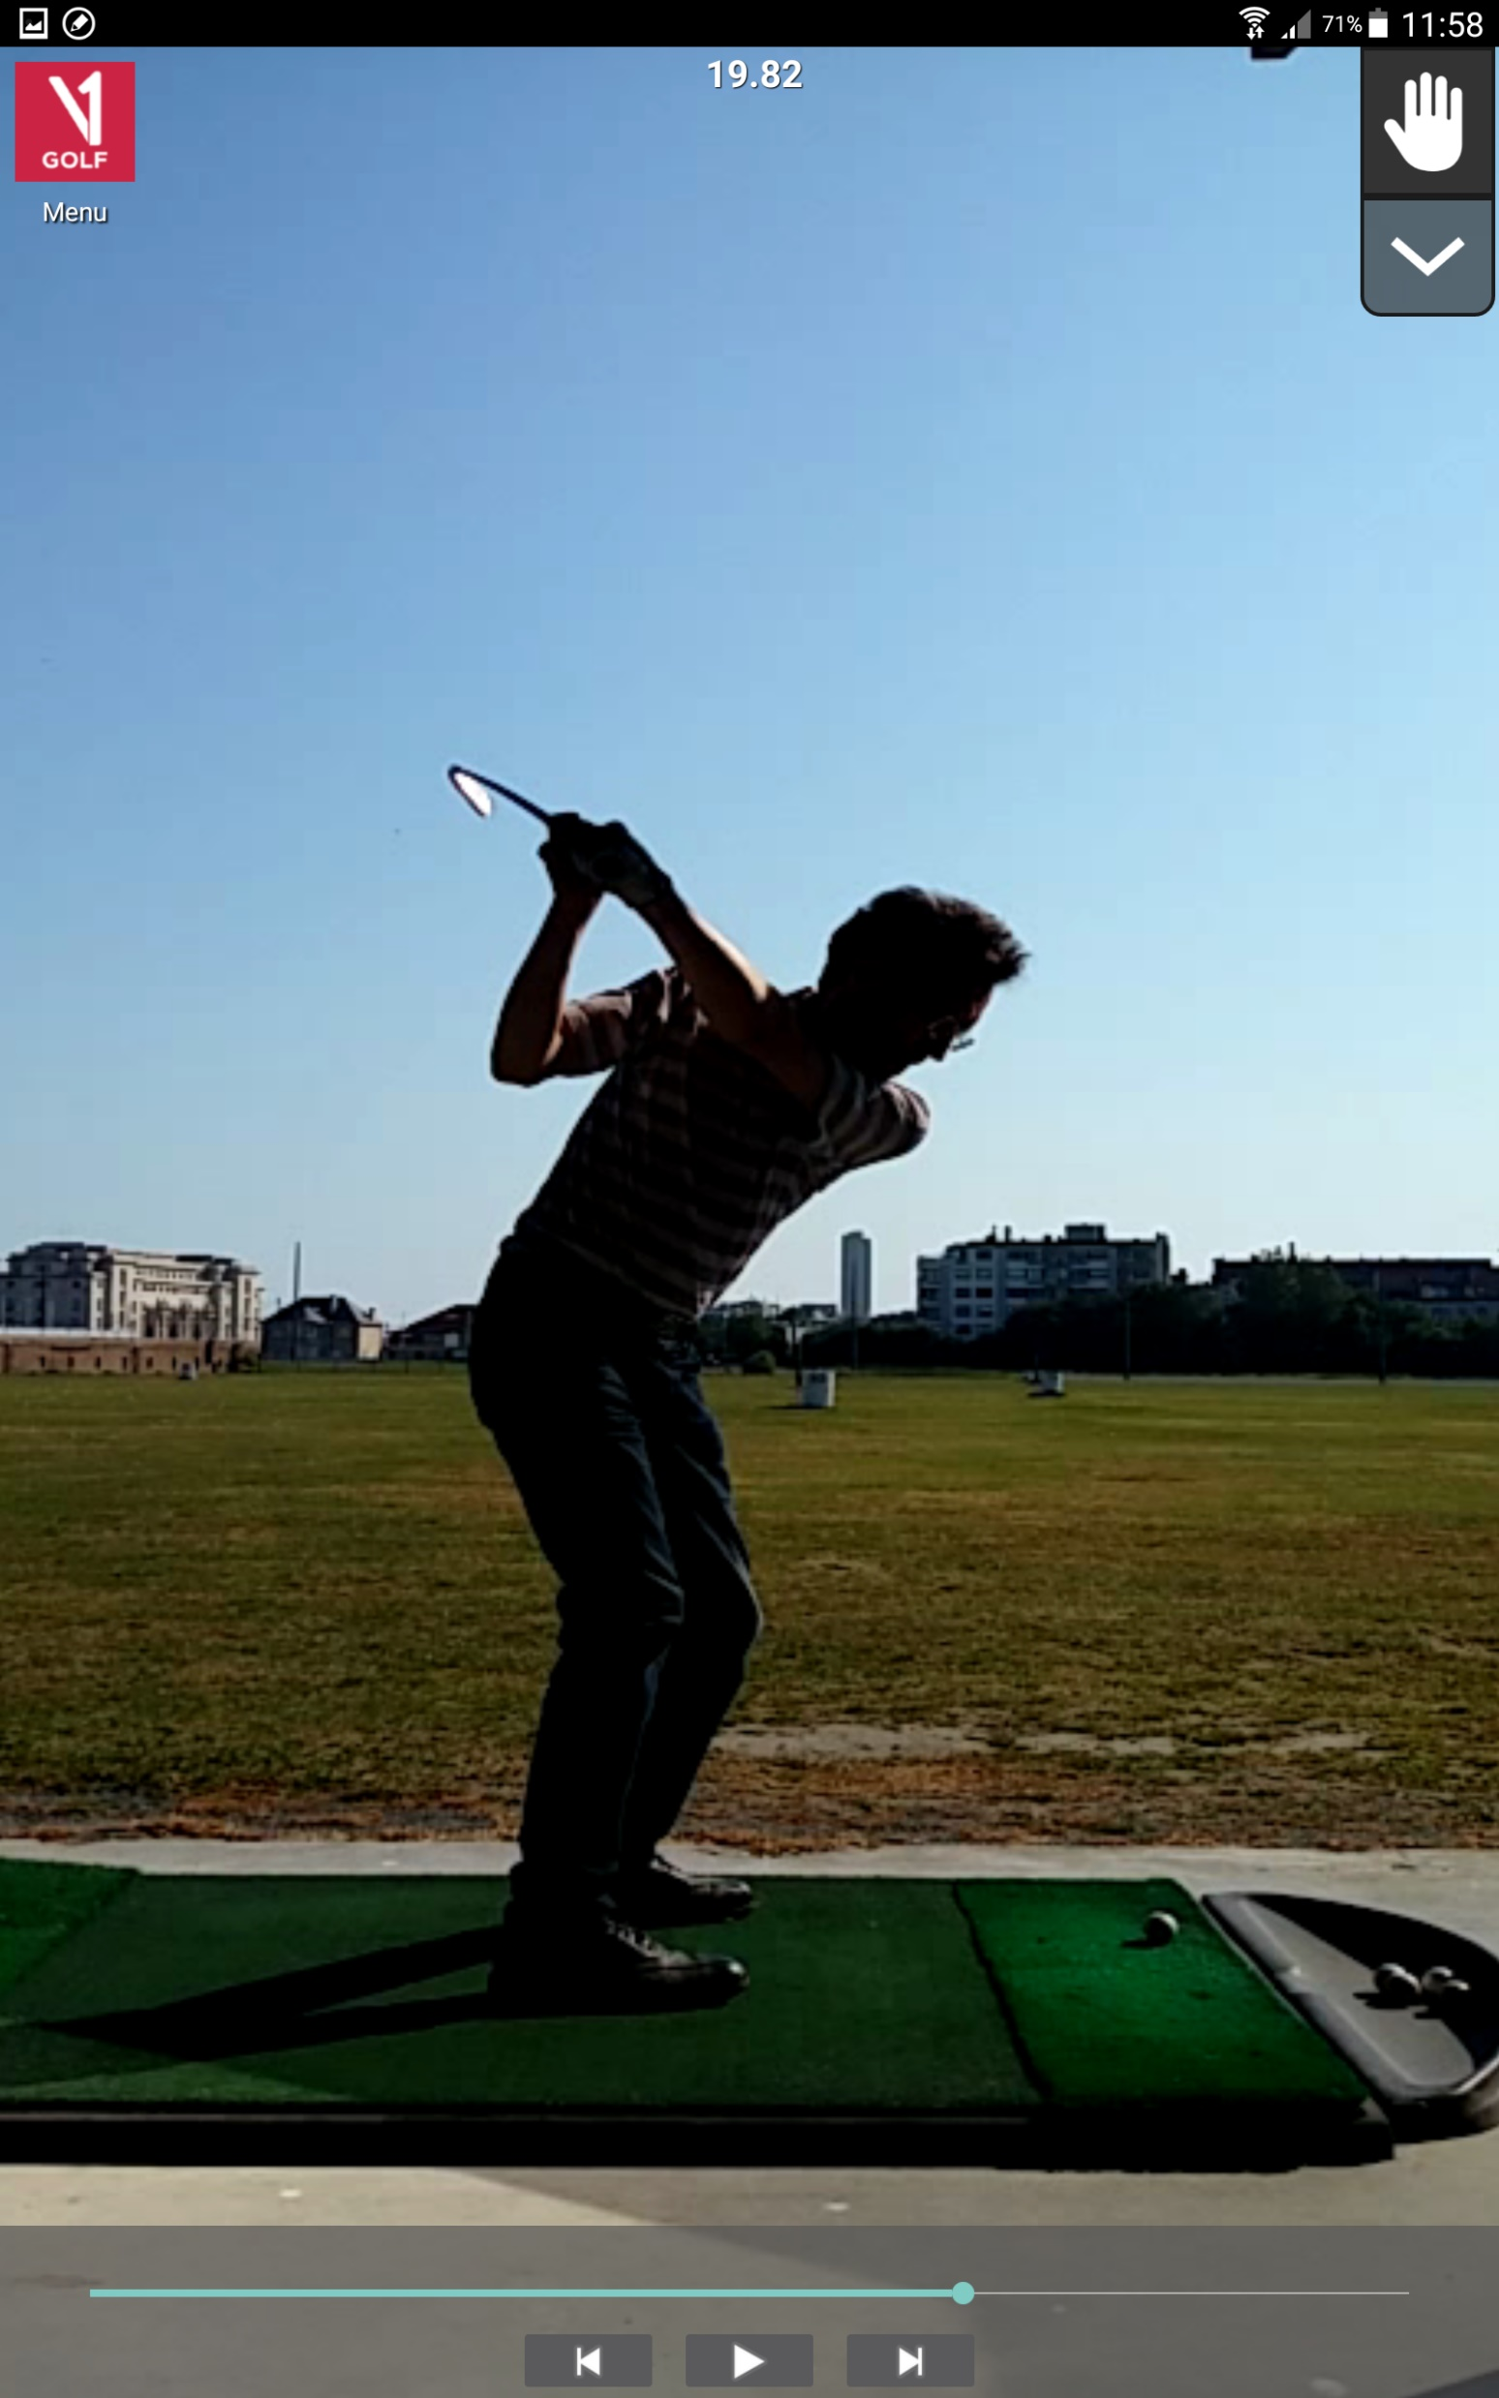
(+) Left wrist starts to supinate
(cause)
(-) Right wrist starts to cup strongly as a result (= an effect)
(-) Turn palm of the right hand away from the target, cup the right wrist
(-) Right elbow starts moving towards the right hip as a result (= an effect)

Slide 24

(-) Flatten the clubshaft more by supinating the left wrist and moving the right elbow towards the target line, in sync with the right hip moving towards the target line
Clubshaft needs to end up behind the upper body at the start of the downswing
(+) Lower body (hips) starts turning towards the target → lower body leads the downswing

Slide 25
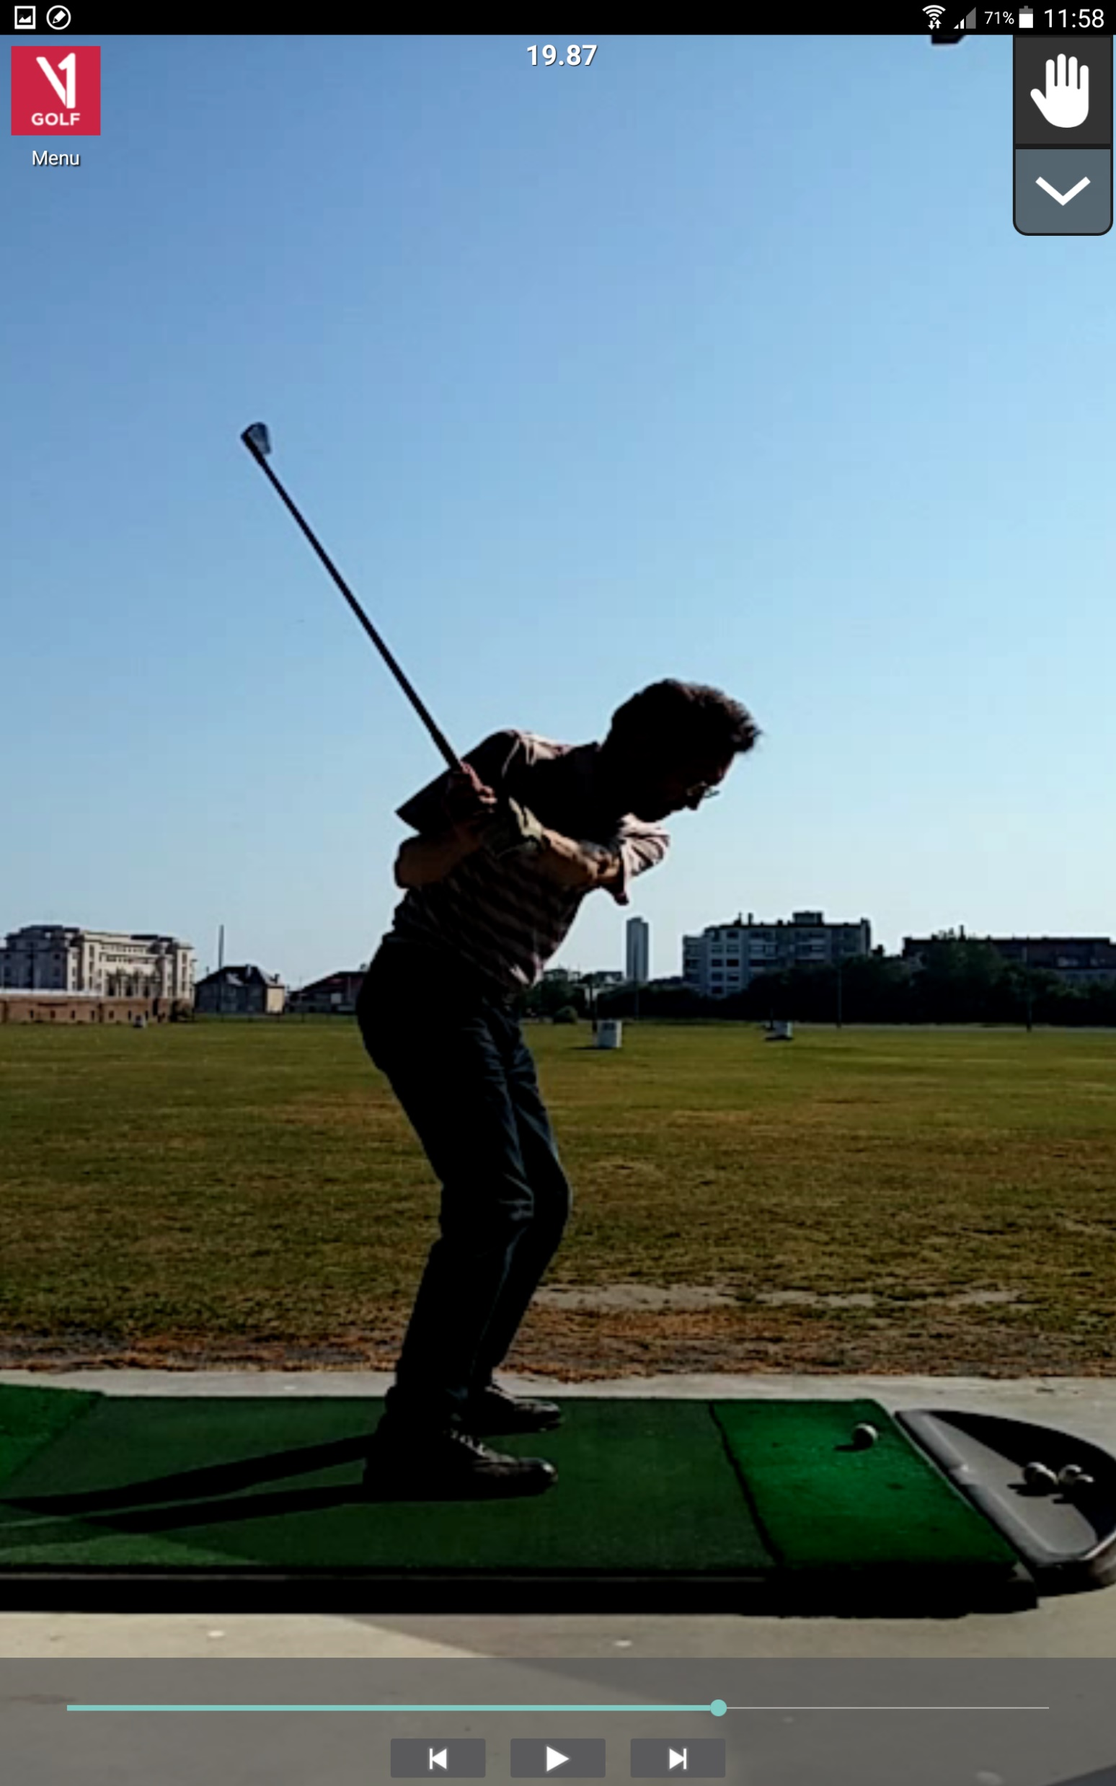
(-) Flatten the clubshaft more by supinating the left wrist and moving the right elbow towards the target line
Clubshaft needs to end up behind the upper body at the start of the downswing
(+) Right arm builds up energy

Slide 26

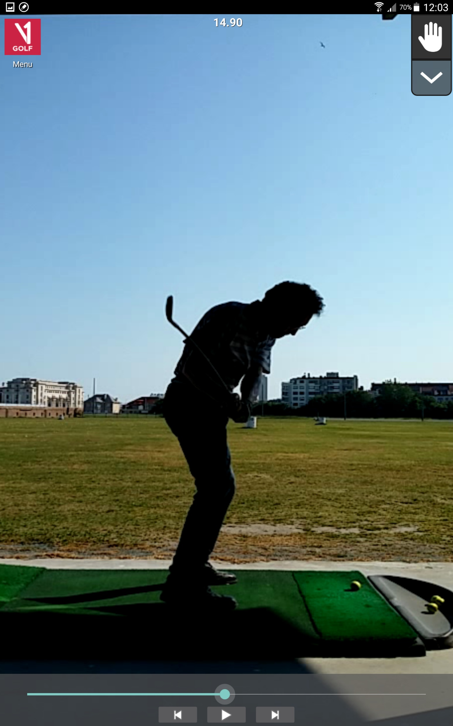
GOOD
BETTER
α
backswing
Downswing plane needs to be much flatter than the backswing plane → showing an “X” as a result of the angle α between both planes
The goal is to get the downswing plane as close as possible to the initial white plane, in particular the clubhead
Goal
downswing
downswing

Slide 27
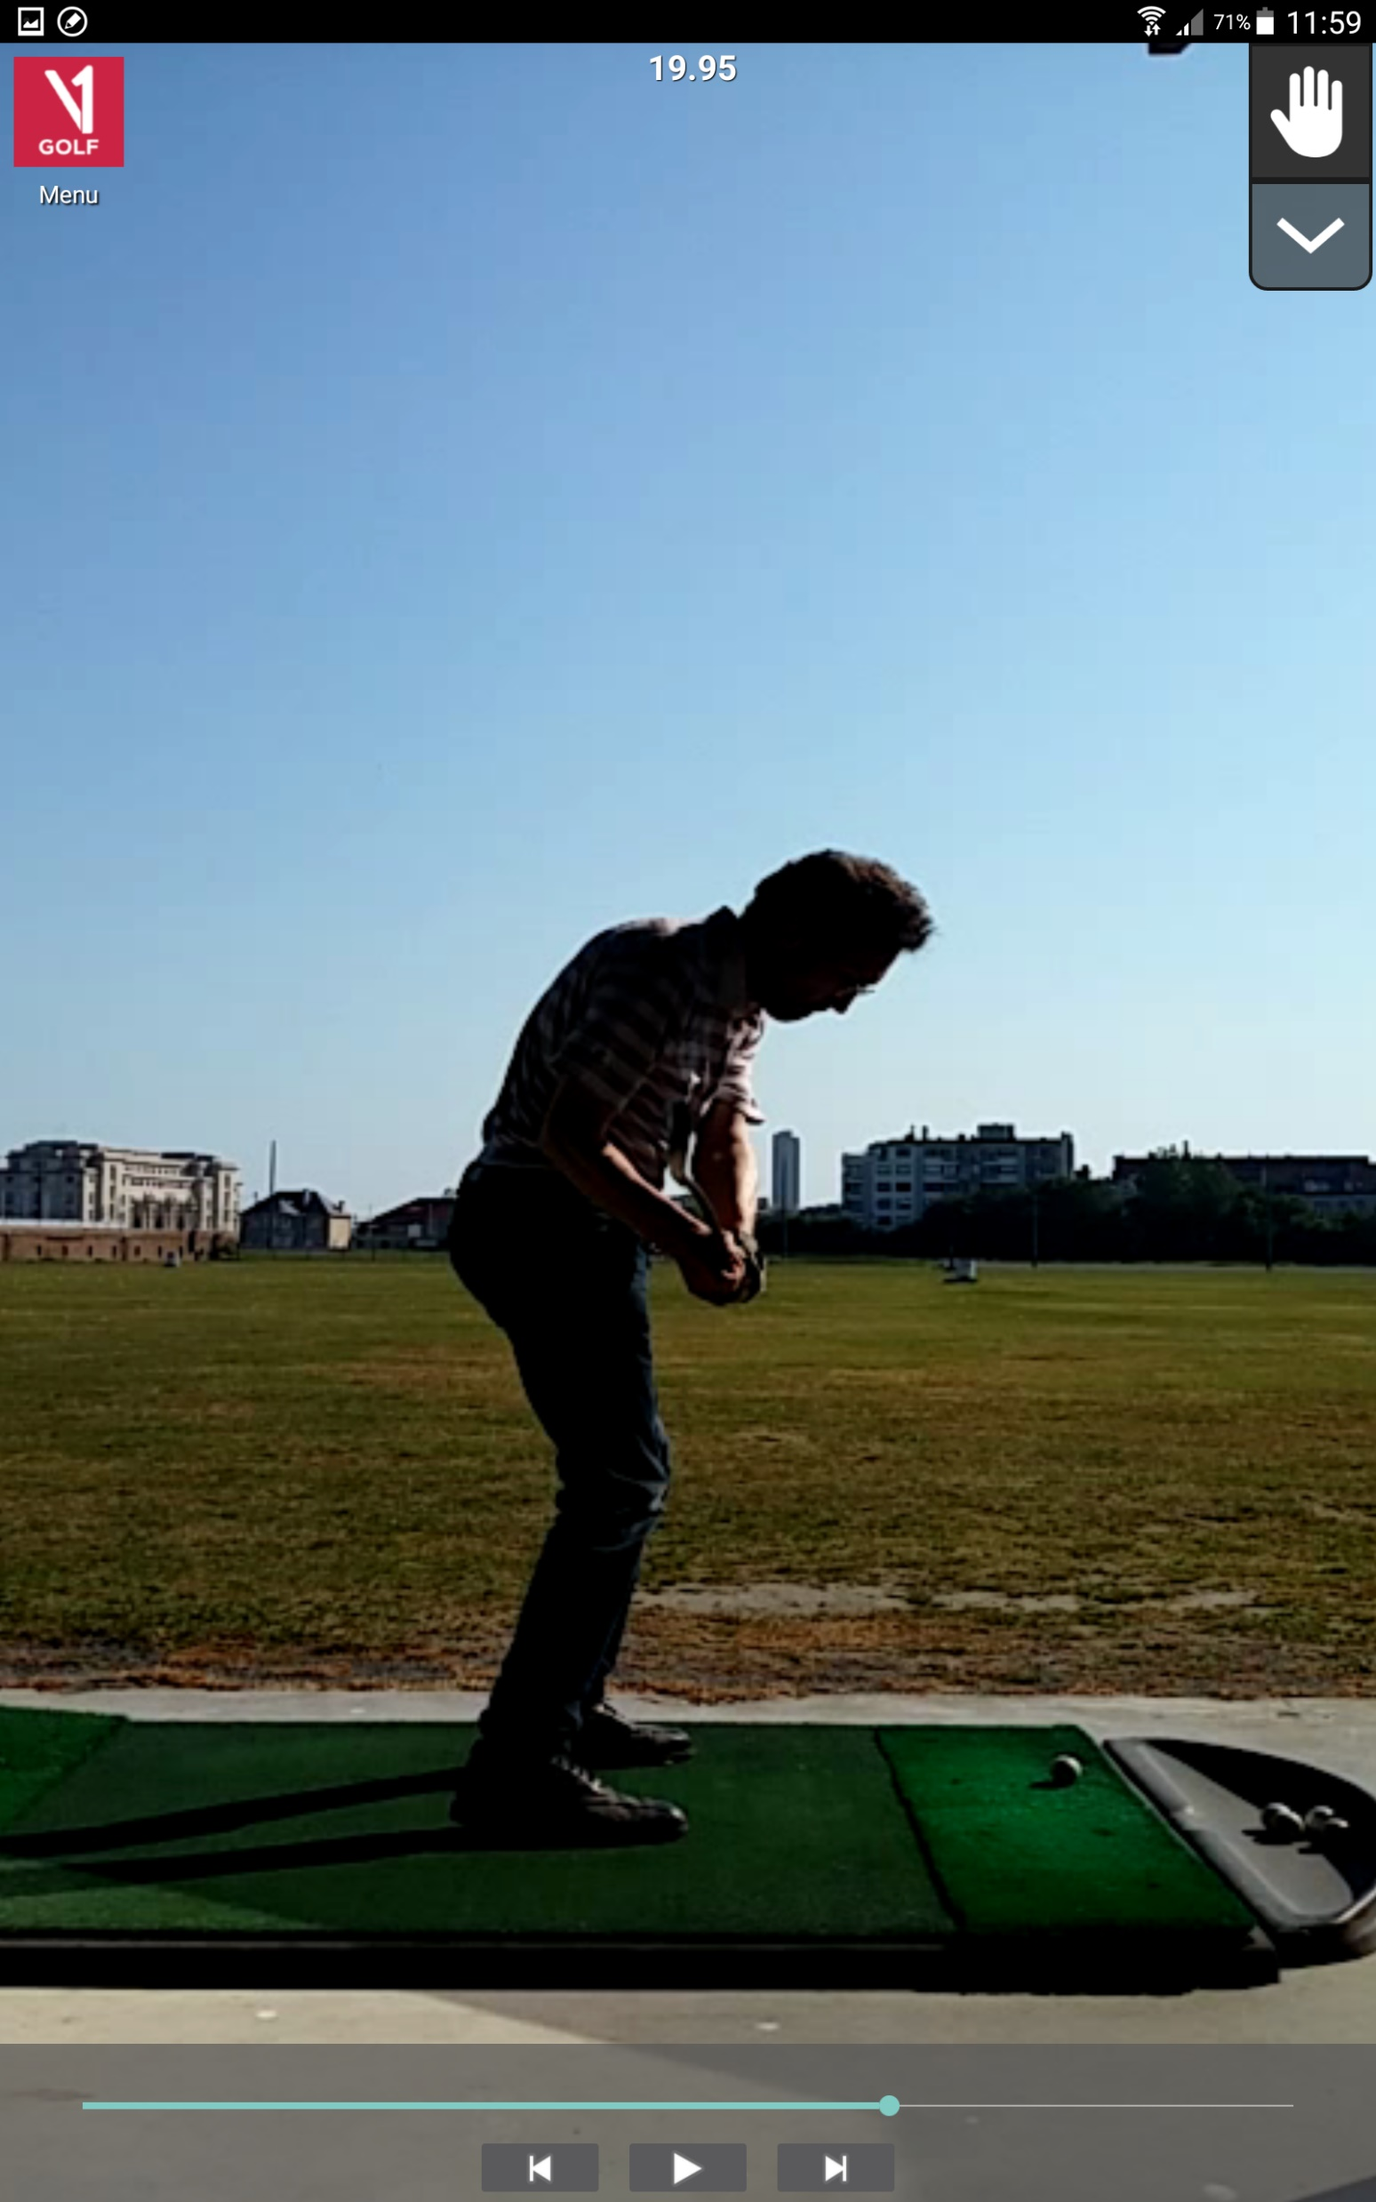
(+) Clubhead will be inside when the clubshaft is horizontal → draw
Practice the swing starting with a flat right hand throwing a ball (Ben HOGAN)

Slide 28

(+) Just before impact, there is still an opening between both arms, right elbow is positioned close to the right hip, right arm is ready to fire

Slide 29

(+) At impact, the hands are closer to the target than the ball
(+) Clubface touches the ground after the ball’s starting position

Slide 30


Slide 31


Slide 32


Slide 33
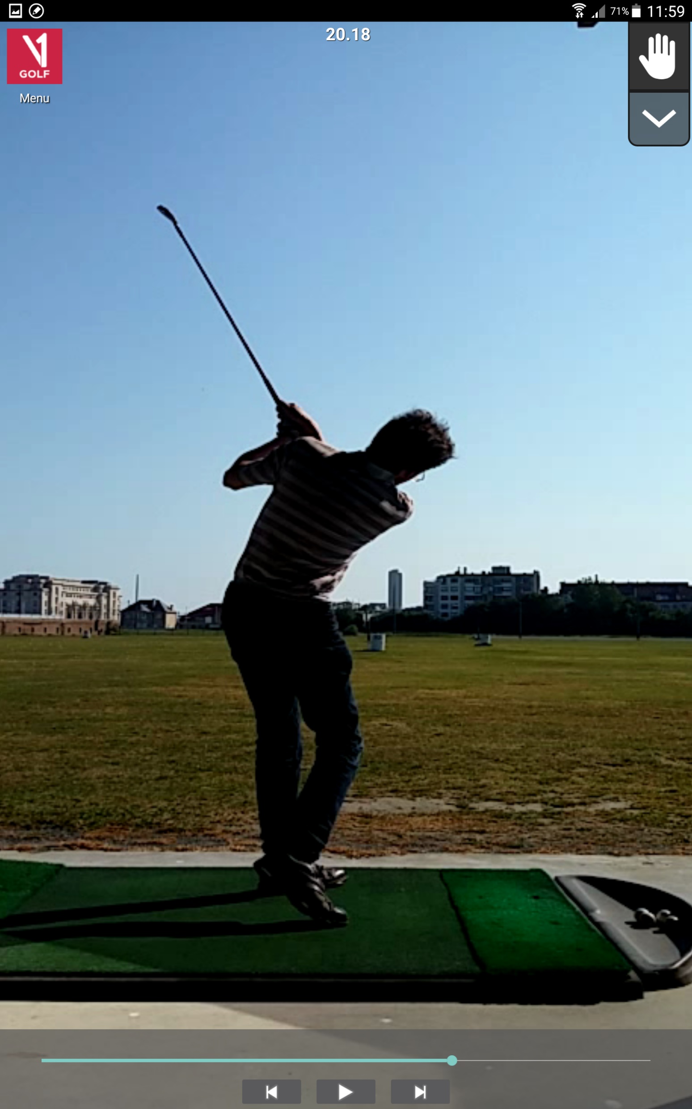

Slide 34
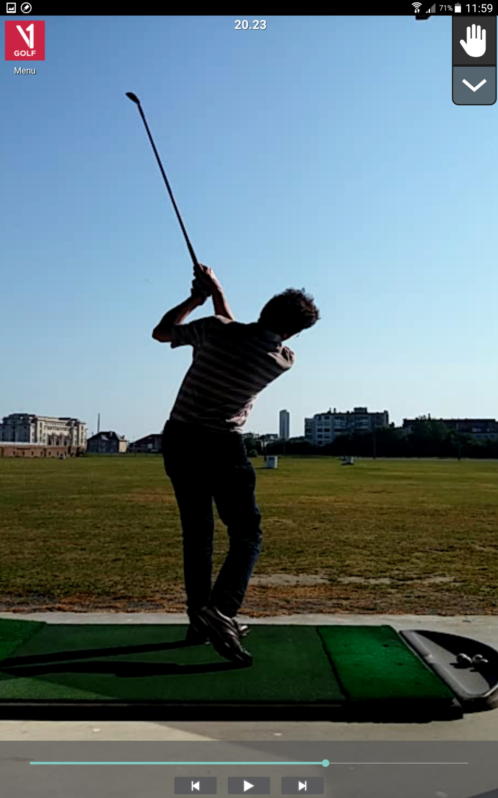

Slide 35
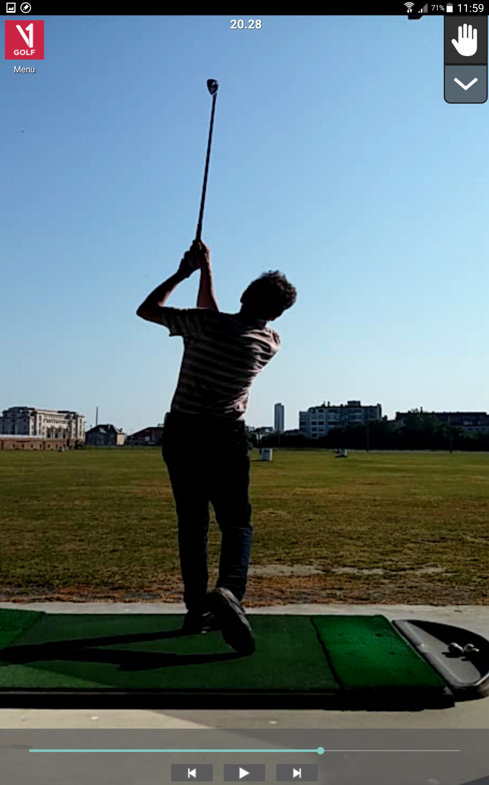

Slide 36
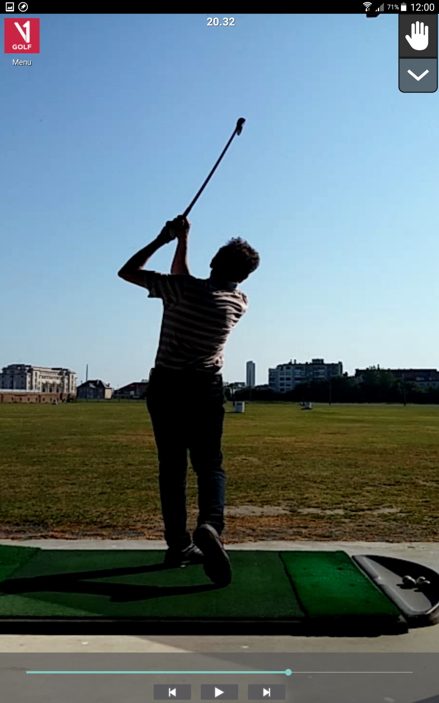

Slide 37
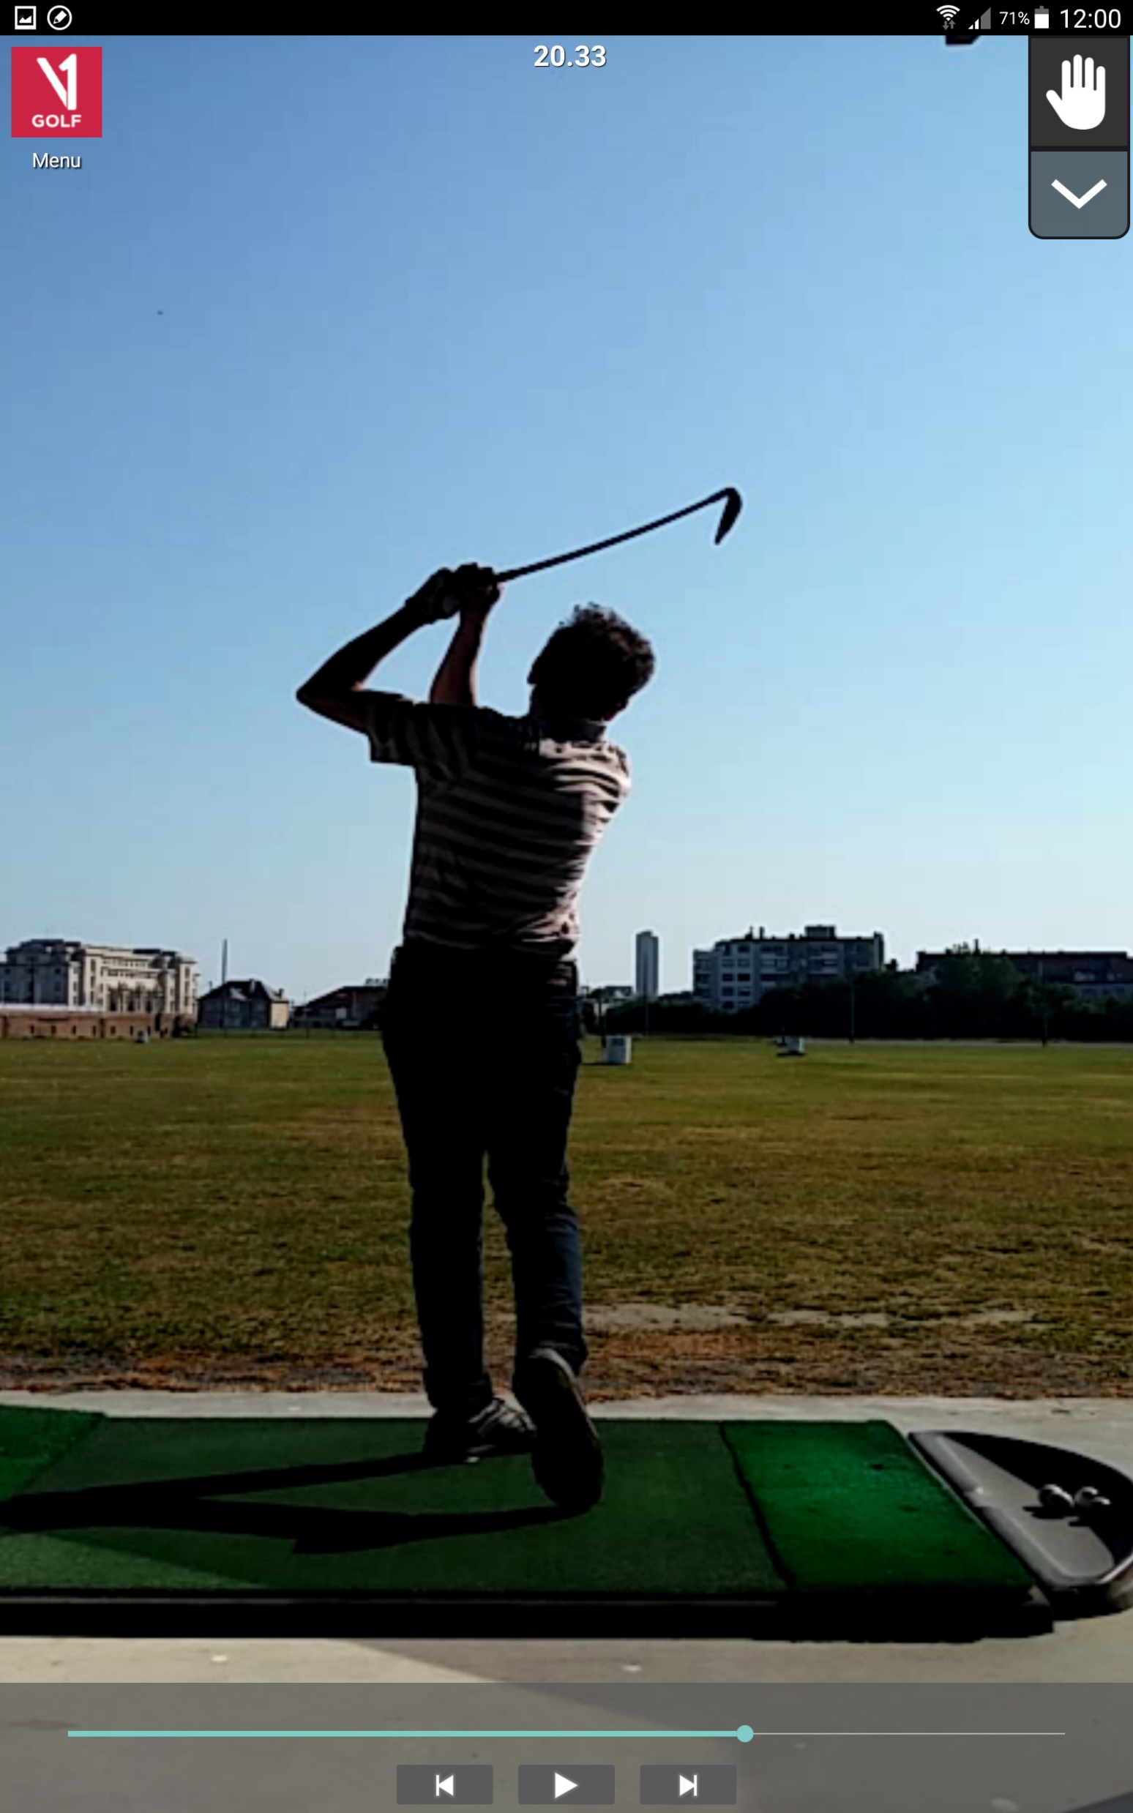

Slide 38
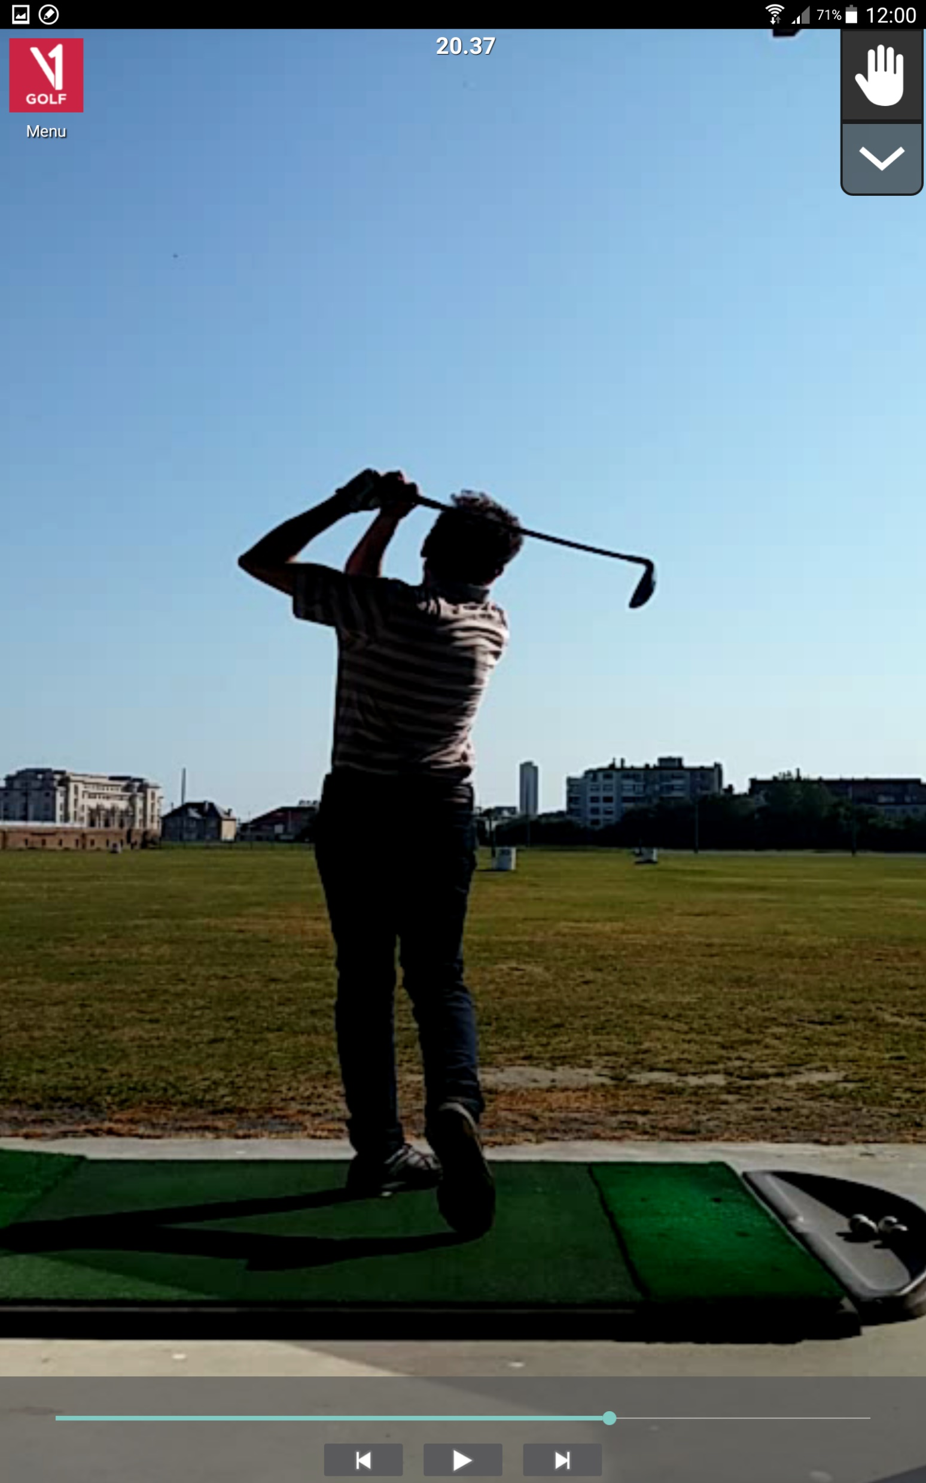
(+) Shaft // shoulder line
(+) Right foot rests on the tip, just like Tiger Woods does

Slide 39
Appendices

